Slide 1
DOT Urine
Collector Training
49 CFR Part 40 REQUIREMENTS

Slide 2





Collector

Slide 3
Serving as a Collector
Any individual, who has received training specified in 49 CFR Part 40 (§40.33) for conducting the required collection procedure, may serve as a collector except in the following situations:
1. The immediate supervisor of a particular employee may not act as the collector when that employee is tested, unless no other collector is available. (The immediate supervisor may act as a monitor or observer (same gender) if there is no one else available at the collection site to conduct a monitored or observed collection.);
2. An employee who is in a safety-sensitive position and subject to the DOT drug testing rules should not be a collector, an observer, or a monitor for co-workers who are in the same testing pool or who work together with that employee on a daily basis.

Slide 4
Serving as a Collector
3. An individual working for an HHS-certified drug testing laboratory (e.g., as a technician or accessioner) may not act as a collector if that individual can link the employee with the specimen drug test result or laboratory report.
4. The employee may not be the collector of his or her own urine specimen.
Note: To avoid a potential conflict of interest, a collector should not be someone that is related to the employee (e.g., spouse, ex-spouse, relative) or a close personal friend (e.g., fiancée).

Slide 5
Collector Identification and Documentation
A collector should have appropriate identification, which includes the collector’s name and the name of the Collection Company or clinic. The collector is required to provide his or her identification if requested by the employee. There is no requirement for the collector to have a picture I.D. or to provide his or her driver's license with an address or telephone number. Also, the collector is not required to provide any certification or other documentation to the employee documenting the collector's training. However, the collector must provide this documentation on request to DOT agency representatives and to employers and service agents (SA) or Consortium/Third Party Administrators (C/TPAs) who are using or negotiating to use that collector’s services.
Employer
The employer must provide the collector with the name and telephone number of the appropriate Designated Employee Representative (DER) and C/TPA, where applicable, to contact about any problems or issues that may arise during the collection process.

Slide 6
Training Curriculum
Urine specimen collection
Perform 5 error-free mock collections
Test
Certificate of completion

Slide 7
DOT
Rules and Regulations Overview

Slide 8
DOT Agencies
Federal Aviation Administration (FAA)
Federal Motor Carrier Safety Administration (FMCSA)
Federal Railroad Administration (FRA)
Federal Transit Administration (FTA)
Pipeline and Hazardous Materials Safety Administration (PHMSA)
United States Coast Guard (USCG)

Slide 9
Federal Aviation Administration (FAA)
  Regulates civil aviation and air traffic.
  Airline flight, crews, flight attendants, air traffic controllers, manufactures and aircrafts.
  Federal Motor Carrier Safety Administration (FMCSA)
  Regulates the safety of commercial motor vehicles.
  Transports merchandises or passengers traveling within the United States.
  Federal Railroad Administration (FRA)
  Regulates railroad safety.
  Covers employers, employees, and railroad equipment.

Slide 10
Federal Transit Administration (FTA)
  Regulates state and local mass transit.
  Mass transit providers, operators of buses, subways, passenger ferry boats and trolleys.
  Pipeline and Hazardous Materials Safety Administration (PHMSA)
  Regulates the safety pipelines and hazardous materials transportation.
  Regulates operators of gas, hazardous liquid and carbon dioxide pipelines, liquefied natural gas facilities.
United States Coast Guard (USCG)
  Regulates commercial boat crews.

Slide 11
People involved in
Processing
(DOT Team Members)

Slide 12
Collector
  Instructs and assists donor in obtaining a urine specimen.
  Completes the paperwork and seals the package while donor is present.
  Ensure shipping of specimen to laboratory for testing.
  Consortium/Third-Party Administrator - C/TPA
  Coordinates drug testing on behalf of employers.
  Handles appointments, testing and record maintenance.
  Designated Employer Representative - DER
  Authorized by employer to receive test results and other information on behalf of the employer.
  Authorized to make important decisions regarding testing.

Slide 13
Employee (Donor)
  Individual testing for DOT drug and alcohol.
  Usually referred as donor.
  Employer
  Sends donor for DOT drug and alcohol testing.
  Delegates tasks to DER to take actions of his behalf.
  Medical Review Officer - MRO
  Licensed physician who interprets and evaluates.
  Makes the determination of negative or positive results.
  Sends reports to employer or DER.

Slide 14
Donor
Refusal to Test

Slide 15
Donor – Refusal to Test
  Refusal to testing or Refusal to submit
  Same meaning
  Terms are used interchangeably
  Donor refusing to submit to a drug and alcohol test
  According to regulations it is = to testing positive

Slide 16
Reasons - Refusal to Test
Not showing to the collection site for testing.
Leaving the collection site before finalizing the collection process.
Decline, unwilling or unable to provide urine specimen.
Refuse to be observed or monitored as per regulations.
Decline to be tested a second time if necessary.
Refuse the MRO’s request to an evaluation of medical examination.
Donor discloses to have adulterated or substituted the urine specimen.
Refuse to adhere to instructions when asked to raise and lower clothing and to turn around to permit the observer to determine if the donor has a prosthetic or other device that could be used to interfere with the collection process.
Use of a prosthetic or other device that could be used to interfere with the collection process.

Slide 17
DOT/Non-DOT Drugs

Slide 18
DOT/Non-DOT Drugs
5 prohibited control substance
Marijuana
Cocaine
Amphetamines
Opiates
Phencyclidine (PCP)

Slide 19
6 Reasons for Testing

Slide 20
1. Pre-Employment
2. Random
3. Post-Accident
4. Reasonable-Suspicion
5. Return-to-Duty
6. Follow-Up

Slide 21
6 Reasons for Testing
1. Pre-Employment
    Donor must test before beginning work at the place of employment.
    Results must be negative before starting employment.
    Employer may employ individual even if positive (case by case).
    Individual will be required to be evaluated by a qualified substance abuse professional and complete a rehabilitative return-do-duty process.
2. Random
    Tests are unannounced.
    Some individual may test several times in the year/some not at all.
    Individual in the pool stays in the pool and will test randomly.
    Selection process is computer-generated.

Slide 22
6 Reasons for Testing
3. Post-Accident
    Employee involved in accident will be tested for drugs.
    Workers' compensation.
4. Reasonable-Suspicion
    Employee showing signs of being under the influence of drugs: slurred speech, dilated or glassy eyes, odor of alcohol, etc.
    Employee will be suspended pending results.
    Must test negative before coming back to work.

Slide 23
6 Reasons for Testing
5. Return-to-Duty
    After testing positive, employee must test negative before returning to work.
    Testing authorization will be determined by the designated employer representative.
    Return to work will be determine by a substance abuse professional.
6. Follow-Up
    After a negative return-to-duty, employee will be part of the follow-up program under the care of the substance abuse professional.
    Employee must take a minimum of 6 unannounced follow-up tests within the first 12 months after returning to work.
    Follow-up can be up to 5 years.

Slide 24
Information Employers Provide to Collectors

Slide 25
49 CFR Part 40 requires the employer or its service agent – for example a C/TPA -- to ensure the collector has the following information when conducting a urine specimen collection for it:
(a) Full name of the employee being tested.
(b) Employee SSN or ID number.
(c) Laboratory name and address (can be pre-printed on the CCF).
(d) Employer name, address, phone number, and fax number (this can be pre-printed on the CCF at Step 1-A).
(e) DER name and telephone number (and C/TPA, where applicable).
(f) MRO name, address, phone number, and fax number (can be pre-printed on the CCF at Step 1-B).
(g) The DOT Agency that regulates the employee’s safety-sensitive duties (the checkmark can pre-printed in the appropriate box on the CCF at Step 1-D)
(h) Test reason, as appropriate: Pre-employment; Random; Reasonable Suspicion/Reasonable Cause; Post-Accident; Return-to-Duty; and Follow-up.
(i) Whether the test is to be observed or not [see 40.67(a) & (b)].
(j) (Optional) C/TPA name, address, phone, and fax number (can be pre-printed on the CCF).

Slide 26
Donor (Employee) - Identification

Slide 27
The employee must provide appropriate identification to the collector at the outset of the collection process. Acceptable forms of identification include:
1. A photo identification (e.g., drivers license, employee badge issued by the employer, or any other picture identification issued by a Federal, state, or local government agency), or
2. Identification by an employer or employer representative, or
3. Any other identification allowed under an operating administration’s rules.
Note: If the employee cannot produce positive identification, the collector must contact a DER to verify the identity of the employee. The collection should not proceed until positive identification is obtained. However, if an owner/operator or other self-employed individual does not have proper identification, the collector should record in the remarks section that positive identification is not available. The owner/operator or other self- employed individual should be asked to provide two items of identification bearing his/her signature. The collector then proceeds with the collection. When the donor signs the certification statement, the collector should then compare the signature on the CCF with the signatures on the identification provided previously by the owner/operator or other self-employed individual. If the signatures appear consistent, the collection process continues. If the signature does not match signatures on the identification presented, the collector should make an additional note in remarks section stating "signature identification is unconfirmed."
Unacceptable forms of identification include:
1. Identification by a co-worker,
2. Identification by another safety-sensitive employee,
3. Use of a single non-photo identification card (e.g., social security card, credit card, union or other membership cards, pay vouchers, voter registration card), or
4. Faxed or photocopies of identification document.

Slide 28
Correctable and Fatal Flaws

Slide 29
Correctable Flaws
Things you missed when completing the form but that did not have any serious adverse effects on the collection process.
The lab will send you an affidavit or a memorandum of record.
Still, you need to:
Complete and send the corrections by fixing what was done wrong
Acknowledge that you did not execute the steps properly and that you will make sure it doesn’t happen again
Sign the document
In the meantime:
Drug screen test is on hold
Urine specimen is not being tested until you return documentation
You have 5 days to respond

Slide 30
Correctable Flaws
Examples of Correctable Flaws, forgot to
Check off needed boxes
Print or sign your name
Have donor sign or initial bottles
Write a note in the remark section
Correctable flaws are usually paperwork issues, administrative mistakes. Nothing that can’t be corrected. Best thing is to correct the mistake and return documentation right away for the lab to complete the collection.

Slide 31
Fatal Flaws
Mistake flaws that cause the test to be cancelled at the laboratory
Laboratory cancels the test
Send cancelled result to the MRO
MRO send cancelled result to the employer
No one is happy
Employee is not happy because they need to retest
The collector will have to go to “error correction training”
No one gets paid for that collection
Error Correction Training

Slide 32
Fatal Flaws
Error Correction Training
Must be completed 30 days from the time of notification
  Collector can continue to do collections
  Receive training on the error that was made
  Must complete 3 mock collections
    1 uneventful mock collection
    2 mock collections related to the error
  Must be completed in front of a person trainer or someone who has been DOT collection for at least a year

Slide 33
Fatal Flaws
Examples of Fatal Flaws
Did not print or sign your name
ID numbers on specimen and form don’t match
  Avoid doing more than 1 collection at the same time.
Insufficient quantity of specimen
  Bottle A 30 ml, Bottle B 15 ml
  Specimen seal is tampered with
***Take your time when performing a DOT specimen collection!

Slide 34
C

Slide 35
Federal Drug Testing Custody and Control Form - CCF

Slide 36
Custody Control Form - CCF
CCF consists of 5 copies
Copy 1: Laboratory or Test Facility Copy – accompanies the specimen to the laboratory
Copy 2: Medical Review Officer Copy – sent to the MRO
Copy 3: Collector Copy – retained by the collector
Copy 4: Employer Copy – sent to the employer
Copy 5: Donor Copy – given to the donor/employee
Completing the CCF
Transmitting CCF copies

Slide 37
Completing the CCF
Step 1
(Copy 1) This step is completed by the collector or employer representative prior to the employee providing a urine specimen.
The employer and MRO names, addresses, and telephone and fax numbers may be preprinted or handwritten.
  If the employer has designated a service agent to receive the results from the MRO, the employer’s address may be omitted and the service agent’s address may be used. However, in all cases, the specific employer’s name, telephone and fax numbers must be included. A clinic or collection site name may not be used in lieu of an employer name
  The collector enters the employee’s social security number or employee’s ID number after verifying the employee’s identity.
  The collector also marks the appropriate box to indicate the reason for the test and the appropriate box for the type of drug tests to be performed (all DOT drug tests are for five drugs).
  The collector is to check the DOT Agency whose authority the specimen is collected. For example, if the employee’s specimen is collected under the authority of the Federal Motor Carrier Safety Administration (FMCSA) regulation, the collector would check the “DOT” and “FMCSA” boxes.
  The collector then enters the information required for the collection site (this information may also be preprinted). The collector’s telephone number is critical, since the laboratory or the MRO may need to contact the collector if they have questions related to a collection.

Slide 38
Completing the CCF
Step 2
(Copy 1)
This step is completed by the collector after receiving the specimen from the employee and observing the temperature of the specimen.
The collector marks the appropriate box to indicate if the temperature of the specimen is within the required temperature range.
The collector indicates whether it is a split specimen or single specimen collection.
Problem: This is where the collector indicates if no specimen was collected and why, and to indicate if it was an observed collection and why.
Note: Because all DOT collections are split specimen collections, the collectors should ALWAYS check the split specimen box.

Slide 39
Completing the CCF
Step 3
(Copy 1)
This step instructs the collector to seal and date the specimen bottles, to date the bottles seals after placing them on the bottles, to have the employee initial the bottle seals after placing them on the bottles, and then instruct the employee to complete step 5 on the MRO copy (Copy 2).

Slide 40
Completing the CCF
Step 5
(Copy 2)
This step is completed by the employee (listed as donor on the CCF). The employee reads the certification statement, prints his or her name, provides date of birth, daytime and evening telephone numbers, date of collection, and signs the form. After the employee completes this portion of the CCF, the collector reviews it to ensure that all the required information was provided.

Slide 41
Completing the CCF
Step 4
(Copy 1)
This step is initiated by the collector and then completed by the laboratory after the laboratory accessions the specimen. This step requires the collector to sign the form to certify that the specimen was collected, labeled, sealed, and released for shipment to the laboratory in accordance with Federal requirements. The collector is also required to note the time of the collection, the date of collection, and the specific name of the delivery service to whom the specimen is released for shipment to the laboratory.
Note: There is no requirement for couriers, express carriers, or postal service personnel to add additional documentation to the chain of custody for the specimens during transit because they do not have direct access to the specimens or the CCF. Chain of custody annotations resume when the shipping container/package is opened and accessioned at the laboratory.

Slide 42
Completing the CCF
Step 5a
(Copy 1)
This step is completed by the laboratory to report the test result of the primary specimen.
Step 5(b) (Copy 1). This step is completed by the laboratory to report the test result of the split specimen if the split specimen is tested.
Step 6 (Copy 2). This step is completed by the MRO in reporting the results of the primary specimen to the employer.

Slide 43
Completing the CCF
Step 7
(Copy 2)
Step 7 (Copy 2). This step is completed by the MRO in reporting the results of the split specimen to the employer.
The bottom area of Copy 1 is reserved for the tamper-evident specimen bottle seals/labels. There must be two seals/labels to accommodate collecting split specimens (i.e., one marked with the letter "A" to designate the primary specimen and the other marked with the letter "B" to designate the split specimen) to accommodate collecting split specimens.
Note: No one (including collection site personnel or the collector) is permitted to require an employee to sign a consent, release, or waiver of liability, or indemnification agreement with respect to any part of the drug testing process. Collection sites (clinics) may not use “generic” consent forms for DOT-required urine specimen collections, even if their clinic policy requires consent from the general patient population.

Slide 44
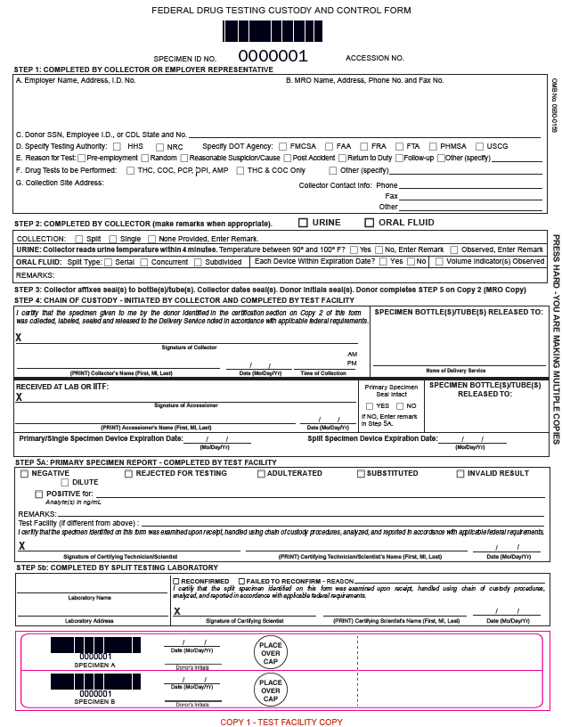

Slide 45
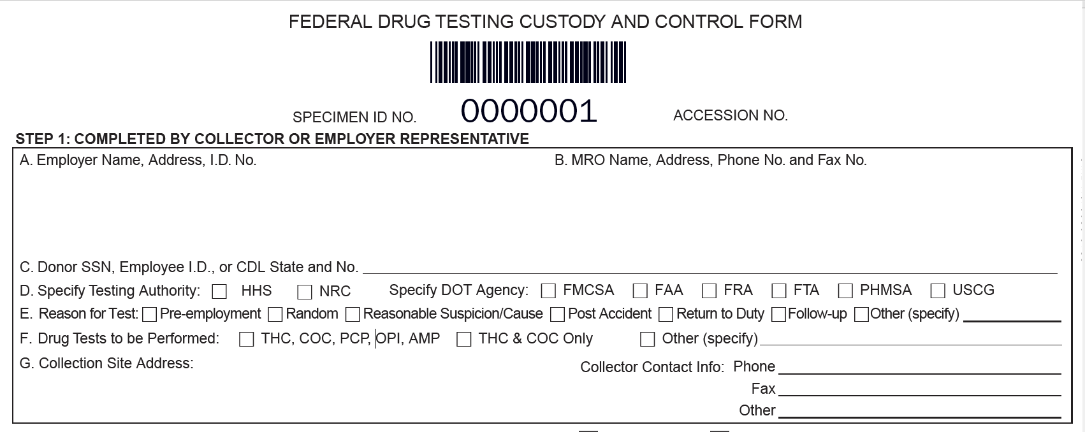

Slide 46
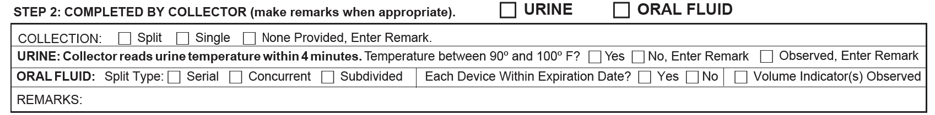

Slide 47
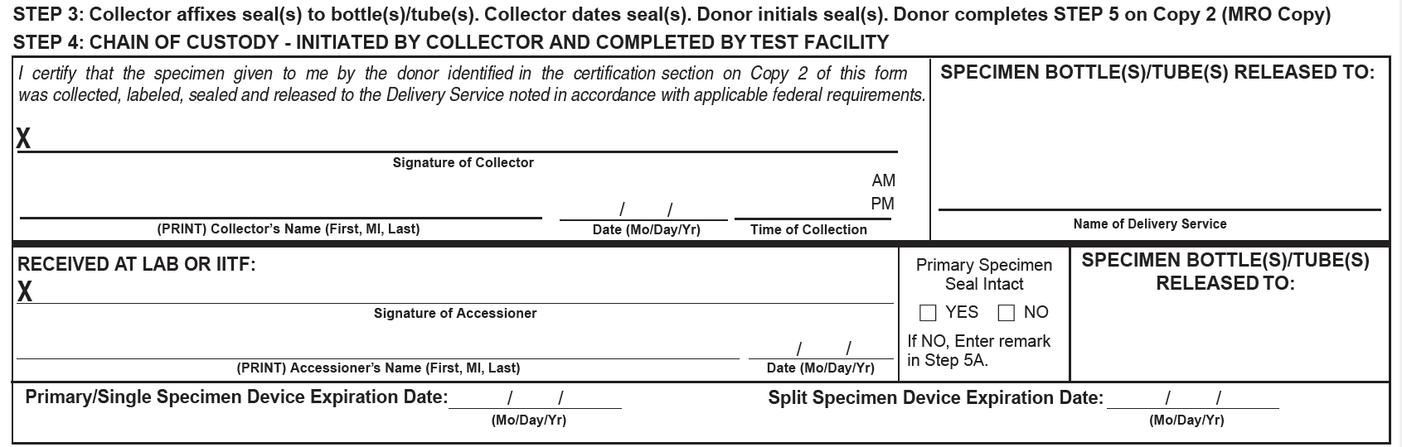

Slide 48
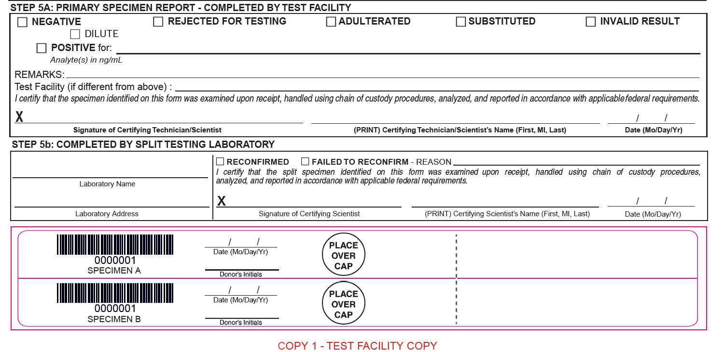

Slide 49
Custody Control Form - CCF
Copies
Copy 1 – Laboratory
Copy 2 – Medical Review Officer (MRO)
Copy 3 – Employer
Copy 4 – Collector
Copy - Donor
Completing the CCF
Transmitting CCF copies

Slide 50
Collector –
Training and Responsibilities

Slide 51
Supplies Needed

Slide 52
Supplies Needed
Must be available at the facility to conduct proper collection
    Urine collection kit
      1 collection cup
      2 plastic specimen bottles
      Specimen bag
      Shipping bag or box
Bluing tablets
(coloring agent to add to the toilet bowl/water tank to prevent an employee from diluting the specimen)
Federal drug testing custody and control forms (CCFs)
Gloves
Tamper-evident tape
(securing faucets, toilet tank tops, and other appropriate areas, and signs, when necessary, that can be posted to prevent entry into collection areas.)

Slide 53
1. Collection Container
a. Single-use container, made of plastic, large enough to easily catch and hold at least 55 mL of urine voided from the body.
b. Must have graduated volume markings clearly noting levels of 45 mL and above.
c. Must have a temperature strip providing graduated temperature readings 32-38 º C / 90-100 º F, that is affixed or can be affixed at a proper level on the outside of the collection container. Other methodologies (e.g., temperature device built into the wall of the container) are acceptable provided the temperature measurement is accurate and such that there is no potential for contamination of the specimen.
d. Must be individually wrapped in a sealed plastic bag or shrink wrapping; or must have a peelable, sealed lid or other easily visible tamper-evident system.
e. May be made available separately at collection sites to address shy bladder situations when several voids may be required to complete the testing process.

Slide 54
2. Plastic Specimen Bottles
a. Each bottle must be large enough to hold at least 35 mL; or alternatively, they may be two distinct sizes of specimen bottles provided that the bottle designed to hold the primary specimen holds at least 35 mL of urine and the bottle designed to hold the split specimen holds at least 20 mL.
b. Must have screw-on or snap-on caps that prevent seepage of the urine from the bottles during shipment.
c. Must have markings clearly indicating the appropriate levels (30 mL for the primary specimen and 15 mL for the split) of urine that must be poured into the bottles.
d. Must be designed so that the required tamper-evident bottle seals made available on the CCF fit with no damage to the seal when the employee initials it nor with the chance that the seal overlap would conceal printed information.
e. Must be wrapped (with caps) together in a sealed plastic bag or shrink wrapping separate from the collection container; or must be wrapped (with cap) individually in sealed plastic bags or shrink wrapping; or must have peelable, sealed lid or other easily visible tamper-evident system.
f. Plastic material must be leach resistant.

Slide 55
3. Leak-resistant Plastic Bag
a. Must have two sealable compartments or pouches which are leak-resistant; one large enough to hold two specimen bottles and the other large enough to hold the CCF paperwork.
b. The sealing methodology must be such that once the compartments are sealed, any tampering or attempts to open either compartment will be evident.
4. Absorbent material
Each kit must contain enough absorbent material to absorb the entire contents of both specimen bottles. Absorbent material must be designed to fit inside the leak-resistant plastic bag pouch into which the specimen bottles are placed.
5. Shipping Container
a. Must be designed to adequately protect the specimen bottles from shipment damage in the transport of specimens from the collection site to the laboratory (e.g., standard courier box, small cardboard box, plastic container).
b. May be made available separately at collection sites rather than being part of an actual kit sent to collection sites.
c. A shipping container is not necessary if a laboratory courier hand-delivers the specimen bottles in the plastic leak-proof bags from the collection site to the laboratory.

Slide 56
Facility Requirements

Slide 57
Facility Requirements
Single Restroom
    Preferred for DOT collections
    Must have:
    Privacy door
    Source of water for washing hands, preferably outside the closed toilet
    If the sink is in the room, must secure with tamper-evident tape:
    Water sources + faucets
    Soap dispensers

Slide 58
Facility Requirements
Multi-Stall Restroom
    Privacy door
    Source of water for washing hands, preferably outside the stall
    You must secure: :
    Water sources + faucets with tamper-evident tape
    Toilet tanks
    Blue tablets
    Soap dispensers
    Monitored:
    Only the donor, the monitor or observer may be present

Slide 59
Testing Site - Authorized/Unauthorized Access
Note: The testing site is that portion of the facility where the collector performs the paperwork, seals the specimens, and where urination occurs. It does not necessarily include the total physical facility (e.g., clinic).
Procedures or restrictions to prevent unauthorized access to the site during the collection:
Prevent the employee or anyone else from gaining unauthorized access to the collection materials/supplies.
The collector must ensure that the employee does not have access to items that could be used to adulterate or dilute the specimen (e.g., soap, disinfectants, cleaning agents, water)
Ensure that all authorized persons are under the supervision of a collector or appropriate site personnel at all times.
Procedures to provide for the secure handling and storage of specimens.
Unauthorized personnel are any individuals that are not specifically authorized by the regulation, the collector, or employer to be present at the collection site.

Slide 60
Testing Site - Authorized/Unauthorized Access
DOT’s 10 Steps to Collection Site Security and Integrity
1. Pay careful attention to employees throughout the collection process.
2. Ensure that there is no unauthorized access into the collection areas and that undetected access (e.g., through a door not in view) is not possible.
3. Make sure that employees show proper picture ID.
4. Make sure employees empty pockets; remove outer garments (e.g., coveralls, jacket, coat, hat); leave briefcases, purses, and bags behind; and wash their hands.
5. Maintain personal control of the specimen and CCF at all times during the collection.
6. Secure any water sources or otherwise make them unavailable to employees (e.g., turn off water inlet, tape handles to prevent opening faucets, secure tank lids).
7. Ensure that the water in the toilet and tank (if applicable) has bluing (coloring) agent in it. Tape or otherwise secure shut any movable toilet tank top, or put bluing in the tank.
8. Ensure that no soap, disinfectants, cleaning agents, or other possible adulterants are present.
9. Inspect the site to ensure that no foreign or unauthorized substances are present.
10. Secure areas and items (e.g., ledges, trash receptacles, paper towel holders, under-sink areas, ceiling tiles) that appear suitable for concealing contaminants.

Slide 61
DO NOT ENTER
TEST IN PROGRESS

Slide 62
Before Collection
(you have a donor ready to test…now what?)

Slide 63
Prepare Site
Checklist
Secure water sources
  Tape faucet handles with tamper-evident tape, or
  Turning off the water inlet
  Drop a blue tablet in the toilet
  Remove soap and other cleaning supplies
  Verify that no products are present
  Tape/secure toilet tank
  Check no undetected access is not available
  Remove trash can
  Lock cabinets

Slide 64
During Collection

Slide 65
Security – Collection in Progress
Checklist
Collector can only conduct one collection at a time.
Unless first donor is a shy bladder, collector can start and finish a second collection.
One collector per donor, unless it’s a shy bladder happening in a middle of collectors changing shift during the three-hour wait.
Collector and donor must keep their eyes on the specimen at all time until specimen is sealed
Collector must remain in the collection area during the entire process.
Collector must be the only one to pour specimen from cup to secured and sealed (tamper-evident) bottles.
Collector must maintain personal control over each specimen and custody and control form during the collection process.

Slide 66
DOT Collector Qualification

Slide 67
DOT Collector – Qualification
Refresher Training
Collector must complete refresher training every 5 years
  Comprehensive overview of all relevant regulations
  Changes to the regulations
  Qualification training components
  5 consecutive error-free mock collections

Slide 68
DOT Collector - Qualification
Error-correction training (when DOT are cancelled)
Refresher every 5 years
Documentation showing meeting the training requirements of 49 CFR Part 40
No need to display
Must be available upon request by DOT auditors, employers and third-party administrators using collector’s services

Slide 69
Policies and Procedures

Slide 70
Policies and Procedures
Businesses always need policies and procedures.
When a drug screen is in progress, access is restricted to:
Only persons authorized at the collection site
  Collectors
  Donors
  Designated employer representatives – DER
  DOT representatives
  Directly observed and Monitor observed collections:
  Donors
  Observers

Slide 71
Mock
Collections

Slide 72
Mock Video
Mock Collection
https://youtu.be/V5dQCh4njNc

Slide 73
Mock Collection
#1
Shy Bladder
# Shy Bladder
  Shy bladder 40 ounces of water or something to drink
  Can’t leave the facility

Slide 74
Mock Collection
#2
Specimen Temperature out of
Range
# Shy Bladder

Slide 75
Mock Video
Temperature Out of Range Specimen
https://youtu.be/MdrIVWWqDl0

Slide 76
Mock Collection
#3
Donor refuses to sign the CCF and initial the specimen bottle tamper-evident seals

Slide 77
Mock Collection
#4
Uneventful
Collections
# Shy Bladder

Slide 78
Mock Collection
#5
Uneventful
Collections

Slide 79
DOT - Videos

Slide 80
Mock Video
Direct Observation Collection
https://youtu.be/GfO6-Yf2VCE

Slide 81
Mock Video
Finding Items to Beat a Test

Slide 82
Mock Video
n

Slide 83
Mock Video
n

Slide 84
Mock Video
n

Slide 85
DOT Urine Collector Training
Policies and Procedures

